Slide 1
Hkhr
Software Development Life Cycle(SDLC) is a disciplined and systematic approach that divides the software development process into various phases, such as requirements, design, and coding.
There are six phases of SDLC:
Feasibility analysis
Requirement analysis and specification
Design
Coding
Testing
Maintenance
Notes:
phase-wise software development process helps you track schedule, cost, and quality of the software projects.

Slide 2
Different types of projects have different requirements.
It is required to tailor the SDLC phases to meet the specific needs of the project.
The tailoring the SDLC phases, gives rise to various software development approaches:
Waterfall approach
Prototyping approach
Spiral approach
Win-win spiral approach
Incremental approach

Slide 3
In the design phase, there are two approaches to software development:
Function-oriented approach:
Is module-centric and concentrates on functions of the software.
Object-oriented approach:
Portrays things as they exist in the real world.
Introduces the concept of inheritance which allows reuse of existing code components.
Supports inheritance, reusability and encapsulation of data, abstraction, and polymorphism.

Slide 4
Overview of Object Oriented Concept
Object Oriented concept state everything in real world can be represent as an object.
It emphasis on data, where object can interact with other object
Object-oriented Design - A problem-solving methodology that produces a solution to a problem in terms of self-contained entities called objects
Object-Oriented Design – It decomposes problems into collaborating objects
Object – An object is a concrete entity that exists in space and time, an instance of a class
An Object has:
State – descriptive characteristics
Behaviors – what it can do (or what can be done to it)
An object is a representative or specimen of a class.
Class – A class is a set of objects that share a common structure and a common behavior of object i.e. It is a blueprint or prototype that defines the variables and the methods common to all objects of a certain kind.
Notes:
Object based programming languages follow all the features of OOPs except Inheritance. Examples of object based programming languages are JavaScript, VBScript etc.

Slide 5
Advantages of Object-Oriented Programming over procedural prgm:
Real-world programming
The object-oriented approach models the real world more accurately than the conventional, procedural approach.
Reusability of code
In the object-oriented approach, you build classes, which can be used by several applications.
Modularity of code
An object can be maintained independently of other objects.
Resilience to change
Object-oriented programming also enables you to evolve various versions of software.
When a change is suggested, the old system need not be completely abandoned and re-built from scratch.
Information hiding
Information hiding ensures data security in a program.

Slide 6
History of OOP
SIMULA 1(1962-65) and SIMULA 67(1967) were the first two OO languages, which introduced the key concepts of OOP : object & classes, subclass, virtual procedure.
Ex of OO Languages are Eiffel (B. Meyer), CLOS(D. bobrow), Java(J. Gosling),C++(Bjarne Stroustrup)

Slide 7
Features of OOP
ENCAPSULATION is used for hide the code and data in a single unit (i.e. object) to protect the data from the outside world(i.e. other class object). Class is the best example of encapsulation. Here object can communicate with other object.
ABSTRACTION is the "abstract form of anything". It ignore the implementation details.
POLYMORPHISM – Polymorphism is briefly described as "one interface, many implementations."
It is an ability to handle the ambiguity of duplicate names
INHERITANCE - A property that allows a class to inherit the data and actions of another class
Notes:
Difference Between Encapsulation and Abstraction
Encapsulation hides the irrelevant details of an object and abstraction makes only the relevant details of an object visible.
Abstraction hide the irrelevant detail at class level i.e. outside the object whereas encapsulation hide the irrelevant detail from inside the class i.e. at behavioral level of an object.
3. Implementation diff - Abstraction is implemented using interface and abstract class while Encapsulation is implemented using private and protected access modifier.
Encapsulation is the technique of making the fields in a class private and providing access to the fields via public methods. If a field is declared private, it cannot be accessed by anyone outside the class, thereby hiding the fields within the class. For this reason, encapsulation is also referred to as data hiding.

Slide 8
Encapsulation
The process of binding code and data together in the form of a capsule.
Benefits of Encapsulation:
The fields of a class can be made read-only or write-only.
A class can have total control over what is stored in its fields.
The users of a class do not know how the class stores its data. A class can change the data type of a field and users of the class do not need to change any of their code.

Slide 9
Abstraction
It is the process of exposing the relevant detail and ignoring the irrelevant detail.
There are two ways to achieve abstraction in java
Abstract class (0 to 100%)
Interface (100%)
Notes:
Abstraction is a process of hiding the implementation details and showing only functionality to the user.

Slide 10
POLYMORPHISM
Polymorphism is briefly described as "one interface, many implementations“.
Polymorphism manifests itself in Java in the form of multiple methods having the same name
Inheritance, Overloading and Overriding are used to achieve Polymorphism in java
There are two types of polymorphism
Compile time polymorphism is method overloading.
Runtime time polymorphism is done using inheritance and interface.
Note: From a practical programming viewpoint, polymorphism manifests itself in three distinct forms in Java:
Method overloading
Method overriding through inheritance
Method overriding through the Java interface

Slide 11
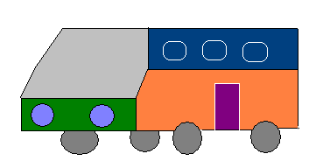

Can you answer these questions?
Car and Bus belong to the same category
Automobile
Can Automobile become a parent class
for Bus and Car? (Yes/No)
Yes
Automobile | How can it be achieved in OOP?
Car and Bus have properties and behaviors of an Automobile
Breaking system of Car is different from braking system of a Bus
Driver need not know details about the engine
The dash board of automobile has all the control to drive the automobile
Inheritance
Polymorphism
Abstraction
Encapsulation

Slide 12
Java
A language developed by Sun Microsystems, 1996
High-level language
It is a pure Object oriented language.
It is Architectural neutral lang.
Notes:
**Comparison between C, C++ and Java
1. Java is more powerful with GUI but C doesn't
2. Java handle error but C and C++ doesnt, we can make erroneous pgm with C like convert string to int but java does not allow
3. In Java all primitive data types are completely define but in C/C++ doesnt Ex. the length of an int in C might be 16 bits on a PC, 32 bits on a workstation, and 60 bits on an old supercomputer but in Java its 32 bits and in java 16 bit char data type allowed portability with Unicode char which include all spoken lang and java string are not array of char its an object.
4. C++ is as a procedural language with some object-oriented features
Java is an object-oriented language with some procedural features
5.

Slide 13
Features of Java
simple
syntax is based on C++ (familiarity → easier transition for programmers)
removed many rarely-used, confusing features
e.g., operator overloading, multiple inheritance, automatic coercions
added memory management (reference count/garbage collection hybrid)
object-oriented
OOP facilities similar C++, but all member functions (methods) dynamically bound
pure OOP – everything is a class, no independent functions
Network-savvy (Distributed)
Use HTTP & FTP extensive libraries for coping with TCP/IP protocols
Java applications can access remote file as the same as local files
Notes:
High-level language - A language that provides a richer (more English like) set of instructions
Compiler / Assembler- A program that translates a high-level language program into machine code
Interpreter / Simulator - A translating program that translates and executes the statements in sequence
Distributed because widely used protocols like HTTP and FTP are developed in java. Internet programmers can call functions on these protocols and can get access the files from any remote machine on the internet

Slide 14
Features of Java (cont.)
Robust (reliable/strong)
Java has the strong memory allocation and automatic garbage collection mechanism
Java combines extensive static checking with dynamic checking
closes C-style syntax loopholes
compile-time checking more effective
Java disallows pointers as memory accessors
arrays & strings are ADTs, no direct memory access
eliminates many headaches, potential problems
secure
in a networked/distributed environment, security is essential
execution model enables virus-free*, tamper-free* systems
downloaded applets cannot open, read, or write local files
uses authentication techniques based on public-key encryption
NOTE: the lack of pointers closes many security loopholes by itself
Notes:
It is secure because No explicit pointer and programs run inside JVM and security provide by JVM are below
Classloader- adds security by separating the package for the classes of the local file system from those that are imported from network sources.
Bytecode Verifier- checks the code fragments for illegal code that can violate access right to objects.
Security Manager- determines what resources a class can access such as reading and writing to the local disk.

Slide 15
Features of Java (cont.)
Dynamic
In Java, memory layout decisions are NOT made by the compiler instead of compiling references down to actual addresses, the Java compiler passes symbolic reference info to the byte code verifier and the interpreter
in C++, if you modify a parent class, you must recompile all derived classes
the Java interpreter performs name resolution when classes are being linked, then rewrites as an address thus, the data/methods of the parent class are not determined until the linker loads the parent class code if the parent class has been recompiled, the linker automatically gets the updated version
Note: the extra name resolution step is price for handling the fragile class problem
Notes:
Java was designed to adapt to an evolving environment e.g., the fragile class problem

Slide 16
Features of Java (cont.)
Multi-threading
a thread is like a separate program, executing concurrently
can write Java programs that deal with many tasks at once by defining multiple threads (same shared memory, but semi-independent execution)
threads are important for multi-media, Web applications
Architecture Neutral
compiler generates an architecture-neutral object file format to enable a Java application to execute anywhere on the network and then the compiled code is executed on many processors, given the presence of the Java runtime system.

Slide 17
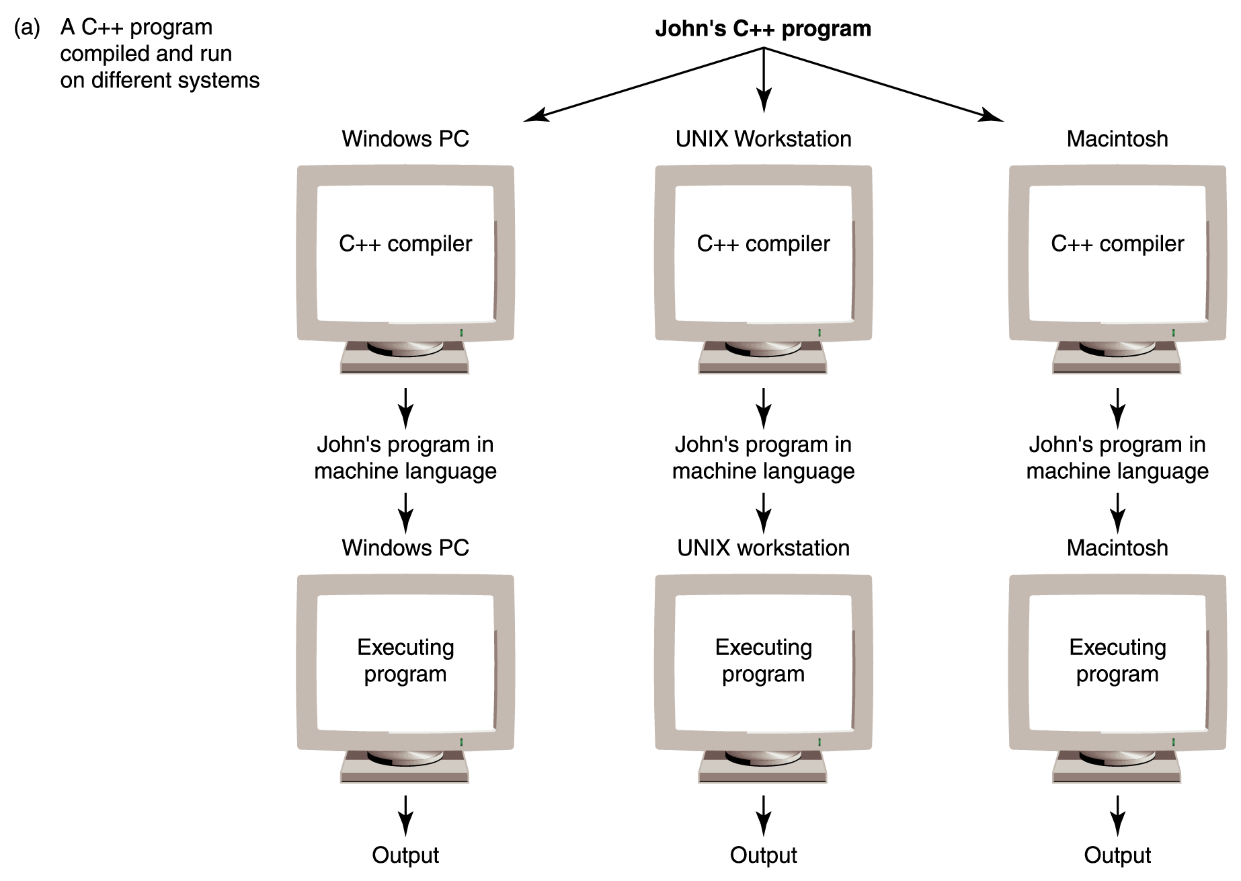
Features of Java (cont.)
Portability in C++
Figure 9.3 Portability provided by standardized languages versus interpretation by Bytecode

Slide 18
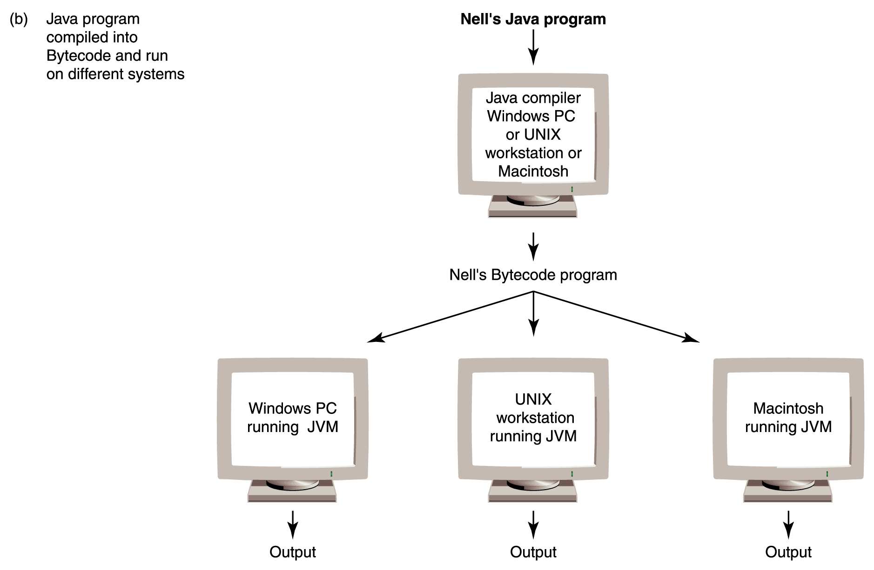
Portability in Java
Features of Java (cont.)
Figure 9.3 Portability provided by standardized languages versus interpretation by Bytecode
Notes:
Java is platform independent language but JVM is platform dependent tool
Java is architectural Neutral because it generate an architecture neutral file that once compiled code will run on any platform without recompiling or any kind of modification i.e. “ Write Once run Anywhere” . It make possible by the use of Java Virtual Machine(JVM)

Slide 19
Java Architecture
Compile-time Environment
JVM Compile-time Environment
Java Source File
(HelloWorld.java)
Class Loader
Bytecode
Verifier
Java Class
Libraries
Java
Interpreter
Just in Time
Compiler
Java
Bytecodes
move locally
or through
network
Java
Virtual
machine
Java
Compiler
javac
Runtime System
Java Bytecode (.class)
Operating System
Hardware
Notes:
Class loader – It loads all classes needed for the execution of a pgm. It add security by separating the namespace for the classes of the local file system from those imported from network sources. Memory layout of the execution file is determine
Bytecode verifier – It test the format of code fragments , violation of access rights etc. It ensure the system integrity. It make four passes
i. There are no access restriction violation
ii. The code causes no operand stack overflows or underflow
iii. No illegal data conversion
iv. ensure the system integrity
Interpreter has two function a> execute byte code b> make appropriate call to the underlying h/w
Java interpreter is used for the execution of the source code
Java uses Just-In-Time compiler to enable high performance. Just-In-Time compiler is a program that turns Java bytecode, which is a program that contains instructions that must be interpreted into instructions that can be sent directly to the processor. Like annotation instruction
Byte code is a binary lang or machine code
cd E:\JAVA\New
path = D:\Program Files\Java\jdk1.5.0\bin
javac filename.java
java filename

Slide 20
Java Virtual Machine(JVM)
JVM is a platform dependent software that is use to interpret the java compiled code into machine lang.
It is an instance of Java Runtime environment
It executes the .class or .jar file by interpreting it or compiling it by using JIT compiler like sun’s HotSpot
It perform 4 main tasks:
Loads Code
Verify code
Execute Code
Garbage Collection
Java uses Just-In-Time compiler to enable high performance. Just-In-Time compiler is a program that turns Java bytecode, which is a program that contains instructions that must be interpreted into instructions that can be sent directly to the processor. Like annotation instruction

Slide 21
Java Virtual Machine(JVM)
JVM have following type of memory area
1. Class(Method) Area: Class(Method) Area stores per-class structures such as the runtime constant pool, field and method data, the code for methods.
2. Heap: It is the runtime data area in which objects are allocated.
3. Stack: Java Stack stores frames. It holds local variables and partial results, and plays a part in method invocation and return. Each thread has a private JVM stack, created at the same time as thread. A new frame is created each time a method is invoked. A frame is destroyed when its method invocation completes.
4. Program Counter Register: PC (program counter) register. It contains the address of the Java virtual machine instruction currently being executed.
5. Native Method Stack: It contains all the native methods used in the application.
Notes:
Native methods are usually used to interface with system calls or libraries written in other programming languages.

Slide 22
JVM Heap
JVM uses heap which is a memory area for the dynamic memory allocation.
The heap is divided in three different segment
Young Generation – it stores the objects which are short lived and garbage collect immediately
Old Generation or Tenured Generation – it stores object that persist longer.
Permanent Generation – store class definition and data associated with it.

Slide 23
Java tools
JDK(Java development kit) – it is a development kit used by java developer to develop java-based application. It include java compiler, java interpreter, developer tools, Java API libraries, documentation.
JRE(Java Runtime environment) – it is a minimum setup that is require to run the java application that includes a java interpreter, java API libraries, java browser plug-in.
Notes:
Path and Classpath are operating system level environment variales. Path is used define where the system can find the executables(.exe) files and classpath is used to specify the location .class files.

Slide 24
Java Keywords
abstract | boolean | break | byte | case | catch
char | class | int | interface | long | native
const | Continue | new | package | private | protected
Default | Do | public | return | short | static
Double | Else | strictfp | super | switch | synchronized
Extends | Final | this | throw | throws | transient
Finally | Float | try | void | volatile | while
For | Goto | If | Implements | Import | instanceof
Notes:
exit, main, null, next, delete, then is not a keyword
The instanceof keyword can be used to test if an object is of a specified type.
if (objectReference instanceof type)
The following if statement returns true.
public class MainClass { public static void main(String[] a) { String s = "Hello"; if (s instanceof java.lang.String) { System.out.println("is a String"); } } }
///is a String
For ttransient goto end of the ppt

Slide 25
Data Types in Java
Java is a Strongly typed language
Unlike C, at runtime type checking is stricktly enforced
Impossible to typecast incompatible types
Two types of Variables : Primitive & Non-primitive i.e reference type / abstract type
Data Types in Java
Primitive (Intrinsic)
Non-Primitive ( Derived)
Numeric
Non-Numeric
Classes
Arrays
Floating Point
Interface
Integer
Character
Boolean
Notes:
primitive datatype(byte,short,int,long,float,double,char,boolean) doesnot contain null value
All numeric primitive data type are signed datatype mean it can contain negative values also.
Data type and its default values
Type Default Value boolean false byte 0 char \u0000 short 0 int 0 long 0L float 0.0f double 0.0d

Slide 26
Primitive Data type
The Java integer primitive types.
Type | Bit Size | Minimum Value | Maximum Value | Defaul
byte | 8 | -128 | 127 | 0
short | 16 | -32,768 | 32,767 | 0
int | 32 | -2,147,483,648( -2₃₁) | 2,147,483,647 (2³²-1) | 0
long | 64 | -9,223,372,036,854,775,808 | 9,223,372,036,854,775,807 | 0
Integer | Long | Octal | Hexadecimal
0 | 0L | 0 | 0x0
1 | 1L | 01 | 0x1
10 | 10L | 012 | 0xA
15 | 15L | 017 | 0XF
16 | 16L | 020 | 0x10
100 | 100L | 0144 | 0x64
Notes:
Byte= 2³ = 8 bit which mean 0000000 or 11111111 whose sum is (2⁸-1)
Similarly short = 2⁴ = 16 bit; int = 2⁵(100000); long = 2⁶(1000000)
signed two's complement integer, which has a minimum value of -2³¹ and a maximum value of 2³¹-1 and unsigned int has a minimum value of 0 and a maximum value of 2³²-1
The signed long has a minimum value of -2⁶³ and a maximum value of 2⁶³-1 and unsigned long has a minimum value of 0 and maximum value of 2⁶⁴-1.
Integer literals can be specified in decimal, hexadecimal, or octal notation.
To specify a decimal value, simply use the number as normal.
To indicate that a literal value is a long, you can append either "L" or "l" to the end of the number.
Hexadecimal values are given in base 16 and include the digits 0-9 and the letters A-F. To specify a hexadecimal value, use 0x followed by the digits and letters that comprise the value.
An octal value is identified by a leading 0 symbol.
For examples of specifying integer literals, see Table 3.7.

Slide 27
Primitive Data type (cont.)
Floating-Point Types
Float (4 bytes i.e. 32 bit)
Double (8 bytes)
To indicate that a literal is to be treated as a single precision float, append either "f" or "F".
To indicate that it is to be treated as a double precision value, append either "d" or "D".
Java includes predefined constants, POSITIVE_INFINITY, NEGATIVE_INFINITY, and NaN, to represent the infinity and not-a-number values.
Char type : char (2 bytes)
Defalt value is null
Logical type : boolean (1 byte) (true/false)
Default value is false
Notes:
Character Literals :-A character literal is a single character or an escape sequence enclosed in single quotes, for example, 'b'. Escape sequences are used to indicate special characters or actions, such as line feed, form feed, or carriage return.
In Java char is of 16bit but in C/C++ it’s of 8bits
Char has a minimum value of '\u0000' (or 0) and a maximum value of '\uffff' (or 65,535 inclusive)

Slide 28
Table 3.8. Escape sequences.
Sequence | Purpose
\b | Backspace
\t | Horizontal tab
\n | Line feed
\f | Form feed
\r | Carriage return
\" | Double quote
\' | Single quote
\\ | Backslash
\uxxxx | Unicode character

Slide 29
Reference Types in Java
Objects, Arrays are accessed using reference variables in Java
A reference variable is similar to a pointer (stores memory address of an object)
Java does not support the explicit use of addresses like other languages
Java does not allow pointer manipulation or pointer arithmetic
A reference type cannot be cast to primitive type
A reference type can be assigned ‘null’ to show that it is not referring to any object
Notes:
string array of main method will be empty but not null if we not pass any argument

Slide 30
Comment entry in Java
Java supports three types of comment delimiters
the traditional /* and */ of C,
the // of C++, and
a new variant that starts with /** and ends with */ used to indicate that the enclosed text is to be treated as a comment by the compiler, but that the text is also part of the automatic class documentation that can be generated using JavaDoc
Syntax : Class header
Description of the class
Date
@author
@version
Note: Do not type class name in header
Syntax: Method header
Description of the method
@param
@return
Note: Do not type method name in header
Notes:
It is not compile in class file

Slide 31
Variables in Java
Using primitive data types in similar to other lang.
In Java, variables can be declare anywhere in the pgm.
In Java, if a local variable is used without initializing it, the compiler will show an error.

Slide 32
Declaration of Variables and Literals
Naming Conventions for Variables:
The name of a variable needs to be meaningful, short, and without any embedded space or symbol.
A variable name must be unique.
A variable name must begin with a letter, an underscore (_), or the dollar symbol ($), which can be followed by a sequence of letters or digits (0 to 9), ‘$’, or ‘_’ .
A variable name should not start with a digit.
A variable name should not contain embedded white spaces .
A variable name should not consist of a keyword.
A variable name in Java is case sensitive.
Notes:
Types of Variables:
Class variables
Instance variables
Local variables
Static variables
Automatic variables
Literals in Java:
Integer literals
Floating point literals
Character literals
String literals
Boolean literals

Slide 33
Typecasting of primitive data types
Implicit Type Conversions –
Java performs a number of implicit type conversions when evaluating expressions. For unary operators (such as ++ or --), the situation is very simple: operands of type byte or short are converted to int
Explicit Type Conversion – whenever a larger type is converted to a smaller type, we have to explicitly specify the type cast operator. It is a unary operator. It also called typecasting.
Double d = 10;
Int i;
I = (int) d;
This prevents accidental loss of data
Notes:
Not all conversions are legal. For instance, boolean values cannot be cast to any other type, and objects can only be converted to a parent class.

Slide 34
Operators and Assignments
Arithmetic Operators
The Bitwise Operators
Relational Operators
Boolean Logical Operators
The ternary operator

Slide 35
1. Arithmetic Operator
Operator | Name | Order of evaluation | Example | Result
+ | Addition | Left to right | c = a+b; | C = 7
- | Subtraction | Left to right | C = a – b; | C = 3
* | Multiplication | Left to right
/ | Division | Left to right
% | Modulus | Left to right | C = a % b; | C = 1
+= | Addition assignment | Right to left
-= | Subtraction assignment | Right to left
*= | Multiplication assignment | Right to left
/= | Division assignment | Right to left
%= | Modulus assignment | Right to left
Note: Here int a = 5; int b = 2; int c = 0;

Slide 36
Arithmetic Operator (contd.)
Operator | Name | Order of Evaluation | Example | Equivalent to | Result
++ | Increment | Right to left | C = a++; | C = a; | C = 5 A = 6
 |  |  |  | A = a + 1;
 |  |  | C = ++a; | A = a + 1; | A = 6 C = 6
 |  |  |  | C = a
-- | Decrement | Right to left | C = a--; | C = a; | C = 5 A = 4
 |  |  |  | A = a - 1;
 |  |  | C = --a; | A = a - 1; | A = 4 C = 4
 |  |  |  | C = a
Note: Here int a = 5; int b = 2; int c = 0;

Slide 37
2. Bitwise Operators
Operator | Name | Example |  |  | Result
~ | Bitwise Unary NOT | c = ~a |  | ~101 | 010
& | Bitwise AND | c = a & b |  | 101 & 011 | 001 = 1
| | Bitwise OR | c = a | b |  | 101 | 011 | 111 = 7
^ | Bitwise XOR | c = a ^ b |  | 101 ^ 011 | 110 = 6
&= | Bitwise AND assignment | a &= b; | a = a & b | 101 & 011 | 001 = 1
|= | Bitwise OR assignment | a |= b; | a = a | b | 101 | 011 | 111 = 7
^= | Bitwise XOR assignment | a ^= b; | a = a ^ b | 101 ^ 011 | 110 = 6
Note: Here int a = 5; int b = 3; int c = 0;

Slide 38
Bitwise Operators
int a = 3; // …00000000011 = 3
int b = -4; // …1111111100 = -4
Operator | Name | Example | Actual | Result
>> | Shift right Based on sign | a = a >> 2 | ..000011 | ..000000 = 0
 |  | b = b >> 2 | ..111100 | ..111111 = -1
>>> | Shift right zero fill | a = a>>> 2 | ..000011 | ..000000 = 0
 |  | b = b >>> 2 | ..111100 | 00..1111 = +big
<< | Shift left Filled with zero | a = a << 2 | ..000011 | ..001100 = 3
 |  | b = b << 2 | ..111100 | ..110000 = -16
>>= | Shift right Based on sign | a >>= 2 | ..000011 | ..000000 = 0
 |  | b >>= 2 | ..111100 | ..111111 = -1
>>>= | Shift right zero fill | a >>>= 2 | ..000011 | ..000000 = 0
 |  | b >>>= 2 | ..111100 | 00..1111 = +big
<<= | Shift left Filled with zero | a <<= 2 | ..000011 | ..001100 = 3
 |  | b <<= 2 | ..111100 | ..110000 = -16

Slide 39
3. Relational Operators

Slide 40
4. Boolean Logical Operators

Slide 41
5. Ternary Operator

Slide 42
Class
A class is a template for an object, and an object is an instance of class.
Data or variables defined within a class are called instance variables.
Collectively, the methods and variables defined within a class are called members of the class.
Here the refName is just a reference that hold only memory addr. It act like pointer in java except we cannot manipulate it like integer as in C++.
Memory declaration of Object are in heap and class reference in stack.
assigning one object reference variable to another object reference variable, are not creating a copy of the object, but making a copy of the reference.
ClassName refName;
Notes:
In .java file, if two classes are define then after compilation two .class file will create.
In .java file, there cannot be more than one public access specified class.

Slide 43
Nested classes
A class declared inside a class is known as nested class.
use nested classes to logically group classes and interfaces in one place so that it can be more readable and maintainable code
it can access all the members of outer class including private data members and methods
Types of Nested Class
There are two types of nested classes non-static and static nested classes. The non-static nested classes are also known as inner classes.
non-static nested class(inner class)
a)Member inner class
b)Annomynous inner class
c)Local inner class
static nested class (there is nothing like static inner class)
Notes:
Inner class is a part of nested class. Non-static nested classes are known as inner classes.
Two class file will create for nested class. The nested class file will have parent name separated with $.

Slide 44
1a. Inner Class
A class that is declared inside a class but outside a method is known as member inner class
Invocation of Member Inner class
From within the class - member inner class that is invoked inside a class
From outside the class - member inner class that is invoked outside a class
Outer.Inner in=obj.new Inner();

Slide 45
1b. Annonymous inner class
A class that have no name is known as annomymous inner class
Annonymous class can be created by
Class (may be abstract class also)
Interface
Notes:
abstract class Person{
abstract void eat();
}
class Emp{
public static void main(String args[]){
Person p=new Person(){
void eat(){System.out.println("nice fruits");}
};
p.eat();
}
}

Slide 46
1b. Annonymous inner class(2)
annonymous inner class by interface
Compiler version
interface Eatable{
void eat();
}
class Emp{
public static void main(String args[]){
Eatable e=new Eatable(){
public void eat(){System.out.println("nice fruits");}
};
e.eat();
}
}
import java.io.PrintStream;
static class Emp$1 implements Eatable
{
Emp$1(){}
void eat(){System.out.println("nice fruits");}
}

Slide 47
1c. Local inner class
A class that is created inside a method is known as local inner class.
If you want to invoke the methods of local inner class, you must instantiate this class inside the method.
Local variable can't be private, public or protected.
Local inner class cannot be invoked from outside the method
Local inner class cannot access non-final local variable.

Slide 48
2. static nested class
A static class that is created inside a class is known as static nested class. It cannot access the non-static members
It can access static data members of outer class including private.
static nested class cannot access non-static (instance) data member or method

Slide 49
Nested Interface
An interface which is declared within another interface or class is known as nested interface. The nested interfaces are used to group related interfaces so that they can be easy to maintain. The nested interface must be referred by the outer interface or class. It can't be accessed directly.
Nested interface must be public if it is declared inside the interface but it can have any access modifier if declared within the class.
Nested interfaces are declared static implicitely
Notes:
we can define a class inside the interface

Slide 50
Constructors
A constructor (default or user defined) is a special method that is called to initialize the newly created object
A constructor method
will have the same name as that of the class
will not have any return type, not even void if given then treat as other method
It may or may not have parameters
Can have public or default access specifier, if private access specifier is define then give runtime error.
Constuctor are never inherit thus cannot be overridden
If no user defined constructor is provided for a class, the implicit constructor initializes the member variables to its default values
numeric data types are set to 0
char data types are set to null character(‘\0’)
boolean data types are set to false
reference variables are set to null
Notes:
It is not mandatory for the coder to write a constructor for the class
constructor can't be final.

Slide 51
Order of execution of constructors
class Employee{
String type;
public Employee(){
System.out.println(“Employee default");
}
}
class Educator extends Employee{
public Educator(){
System.out.println(“Educator default");
}
}
class CheckApplication{
public static void main(String [] args){
Educator educator = new Educator();
//more code to complete main() method
}
}
Object class constructor
Call to
Execute all the statements in Super class constructor
Sub class constructor then calls the super class construtor before executing any statement inside the sub class’s construtor.
Call to parameterless constructor of sub class

Slide 52

Constructor and Access Specifiers (1/3)
public class Automobile {
Automobile() {
System.out.print("Inside Automobile class constructor");
}
public static void main(String [] args) {
Automobile automobile = new Automobile();
}
}
public
private
Output:

Slide 53
Constructor and Access Specifiers (2/3)
class Automobile {
Automobile() {
System.out.print(“Inside Automobile class constructor");
}
}
public class Car {
public static void main(String [] args) {
Automobile automobile = new Automobile();
}
}
private
public
Output:
Error: Automobile() has private access in Automobile

Slide 54
this
this is a reference variable that refers to the current object.
Call to this() must be the first statement in constructor.
Here is given the 6 usage of this keyword
this keyword can be used to refer current class instance variable.
this() can be used to invoke current class constructor.
this keyword can be used to invoke current class method (implicitly)
this can be passed as an argument in the method call.
this can be passed as argument in the constructor call.
this keyword can also be used to return the current class instance.

Slide 55
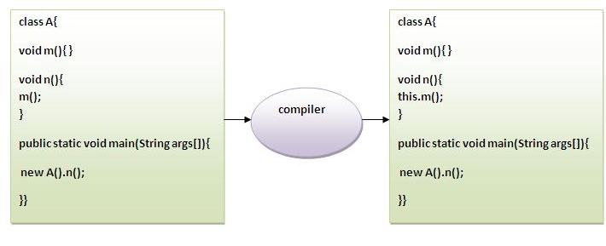
this keyword can be used to invoke current class method (implicitly)
Notes:
javaTpoint.com

Slide 56
finalize() method
finalize() is called before Garbage collector reclaim the Object, its last chance for any object to perform cleanup activity i.e. releasing any system resources held, closing connection if open etc.
Best way to call super class finalize method is to call them in finally block as shown in below example
@Override protected void finalize() throws Throwable { try{ System.out.println("Finalize of Sub Class"); //release resources, perform cleanup ; }catch(Throwable t){ throw t; }finally{ System.out.println("Calling finalize of Super Class"); super.finalize(); } }
Notes:
finalize() is invoked at instance destruction by the JVM
Why finalize is declared protected instead of public"?
As finalize() method is defined in java.lang.Object class and we call it manually for performing cleanup activity. So making it private is restricting it access specifier which against the rule of inheritence. By making finalize private prevents it from being overridden in subclass as you can not override private methods, so making it protected
finalize() defined in java.lang.Object class and is define as protected.
It is not call automatically like constructor so its better to call them for parent class.
finalize method is called by garbage collection thread only once

Slide 57
Instance initializer block
Instance Initializer block is used to initialize the instance data member. It run each time when object of the class is created.
it seems that instance initializer block is firstly invoked but NO. Instance intializer block is invoked at the time of object creation. The java compiler copies the instance initializer block in the constructor after the first statement super().

Slide 58
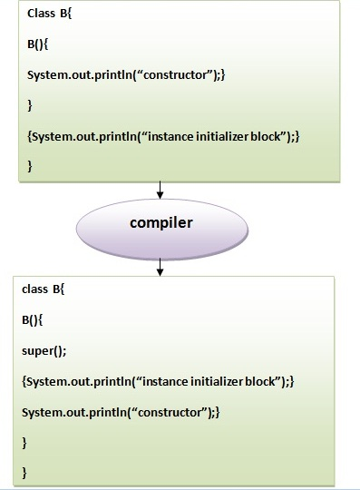

Slide 59
Instance initializer block
There are mainly three rules for the instance initializer block. They are as follows:
The instance initializer block is created when instance of the class is created.
The instance initializer block is invoked after the parent class constructor is invoked (i.e. after super() constructor call).
The instance initializer block comes in the order in which they appear.
Instance initializer initialize before the constructor initialize

Slide 60
Object class
Object class is the parent class of all the classes in java by default.
Object class is beneficial if you want to refer any object whose type we don't know.
parent class reference variable can refer the child class object, know as upcasting

Slide 61
Methods of Object class
Method | Description
public final ClassgetClass() | returns the Class class object of this object. The Class class can further be used to get the metadata of this class.
public int hashCode() | returns the hashcode number for this object.
public boolean equals(Object obj) | compares the given object to this object.
protected Object clone() throws CloneNotSupportedException | creates and returns the exact copy (clone) of this object.
public String toString() | returns the string representation of this object.
public final void notify() | wakes up single thread, waiting on this object's monitor.
public final void notifyAll() | wakes up all the threads, waiting on this object's monitor.

Slide 62
Methods of Object class
Method | Description
public final void wait(long timeout)throws InterruptedException | causes the current thread to wait for the specified milliseconds, until another thread notifies (invokes notify() or notifyAll() method).
public final void wait(long timeout,int nanos)throws InterruptedException | causes the current thread to wait for the specified miliseconds and nanoseconds, until another thread notifies (invokes notify() or notifyAll() method).
public final void wait()throws InterruptedException | causes the current thread to wait, until another thread notifies (invokes notify() or notifyAll() method).
protected void finalize()throws Throwable | is invoked by the garbage collector before object is being garbage collected.
Notes:
suggesting that the JVM performs garbage collection
System.gc();

Slide 63
There are 4 basic types of methods:
Modifier (sometimes called a mutator)
Changes the value associated with an attribute of the object
E.g. A method like Change_Car_Color
Accessor
Returns the value associated with an attribute of the object
E.g. A method like Price_of_Car
Constructor
Called once when the object is created (before any other method will be invoked)
E.g. Car(Mustang)
Destructor
Called when the object is destroyed
E.g.~Car( )

Slide 64
instanceof
instanceof operator is used to test whether the object is an instance of the specified type (class or subclass or interface).
the instanceof operator with any variable that have null value, it returns false
class Animal{}
class Dog extends Animal{//Dog inherits Animal
public static void main(String args[]){
Dog d=new Dog();
Dog d2 = null;
System.out.println(d instanceof Animal);//true
System.out.println(d2 instanceof Animal);//false
}
}
Notes:
Dog d=null;
System.out.println(d instanceof Dog);//false

Slide 65
Serialization
Serialization in java is a mechanism of writing the state of an object into a byte stream.
All subtypes of a serializable class are themselves serializable
Serializable is a marker interface i.e. tagging interface (has no body). It is just used to "mark" java classes which support a certain capability.
The reverse operation of serialization is called deserialization.
The String class and all the wrapper classes implements java.io.Serializable interface by default.
Serializable class associates with a version number called serialVersionUID during runtime, which is used during deserialization
It throw InvalidClassException while using wrong serialVersionUID during deserialization
"serialVersionUID" that must be static, final, and of type long
Notes:
The serialization runtime associates with each serializable class a version number, called a serialVersionUID, which is used during deserialization to verify that the sender and receiver of a serialized object have loaded classes for that object that are compatible with respect to serialization.
If the receiver has loaded a class for the object that has a different serialVersionUID than that of the corresponding sender's class, then deserialization will result in an InvalidClassException. A serializable class can declare its own serialVersionUID explicitly by declaring a field named "serialVersionUID" that must be static, final, and of type long:
ANY-ACCESS-MODIFIER static final long serialVersionUID = 42L;If a serializable class does not explicitly declare a serialVersionUID, then the serialization runtime will calculate a default serialVersionUID value for that class based on various aspects of the class, as described in the Java(TM) Object Serialization Specification. However, it is strongly recommendedthat all serializable classes explicitly declare serialVersionUID values, since the default serialVersionUID computation is highly sensitive to class details that may vary depending on compiler implementations, and can thus result in unexpected InvalidClassExceptions during deserialization. Therefore, to guarantee a consistent serialVersionUID value across different java compiler implementations, a serializable class must declare an explicit serialVersionUID value. It is also strongly advised that explicit serialVersionUID declarations use the private modifier where possible, since such declarations apply only to the immediately declaring class--serialVersionUID fields are not useful as inherited members.

Slide 66
Serialization [2]
It must be implemented by the class whose object you want to persist.
It is mainly used in Hibernate, RMI, JPA, EJB, JMS technologies.
Advantage of Java Serialization
It is mainly used to travel object's state on the network (known as marshaling).
Notes:
ObjectInputStream and ObjectOutputStream are high-level streams that contain the methods for serializing and deserializing an object
When super classes are not serializable, subclasses take the responsibility of saving and restoring the state of super-type’s public, protected and (if accessible) package fields. For that to happen, super classes should have an accessible no-arg constructor to initialize class’s state.

Slide 67
Transient
transient keyword is used in serialization process to prevent any variable from being serialized / persist
Transient keyword can only be applied to fields or member variable. Applying it to method or local variable is compilation error. n declare an variable static and transient at same time and java compiler doesn't complain
can apply transient and final keyword together to a variable Transient variable in java is not persisted or saved when an object gets serialized.
Notes:
Serialization is a process by which object's state is saved by JVM and during deserializaiton it’s recovered by JVM. During Serialization all property of object gets saved except static and transient.

Slide 68
Volatile
volatile keyword in Java, application programmer ensures that its value should always been read from main memory and thread should not used cached value of that variable from there own stack.
1) Volatile keyword can only be applied to variable, it can not be applied to class or method. using volatile keyword along with class and method is compiler error. 2) volatile is also refered as modifier in Java.

Slide 69
Modifier
The static modifier for creating class methods and variables
The final modifier for finalizing the implementations of classes, methods, and variables.
The abstract modifier for creating abstract classes and methods.
The synchronized and volatile modifiers, which are used for threads.

Slide 70
Native method
Native methods are usually used to interface with system calls or libraries written in other programming languages.
Native methods are the methods used to call C/C++ pgm method from java pgm. It define in java pgm with native keyword and without body part.
The mechanism used to integrate C code with a Java program is called the Java Native Interface (JNI)
Notes:
Refer Complete reference
Calling Java from an application written in another language is often referred to as embedding, and the process requires an understanding of the Invocation API. The JNI also provides a way for applications written in other languages to call Java.
Why do I need to use the JNI?
standard Java class libraries do not support the platform-dependent features needed by the application.

Slide 71
strictfp
Strictfp is known for strict floating point calculation
By modifying class and method with strictfp as
Strictfp class MyClass{
When a class is modified by strictfp, all the methods in the class are also modified by strictfp automatically

Slide 72
Cloneable interface
A clone of an object is an object with distinct identity and equal contents.
To define clone, a class must implement java.lang.Cloneable interface and must override Object’s clone method with a public modifier
cloneable interface does not contain the clone method, and Object’s clone method is protected.
If you override the clone method in a non final class, you should return an object obtained by invoking super.clone
Notes:
If we don't implement Cloneable interface, clone() method generatesCloneNotSupportedException.

Slide 73
asf

